Slide 1
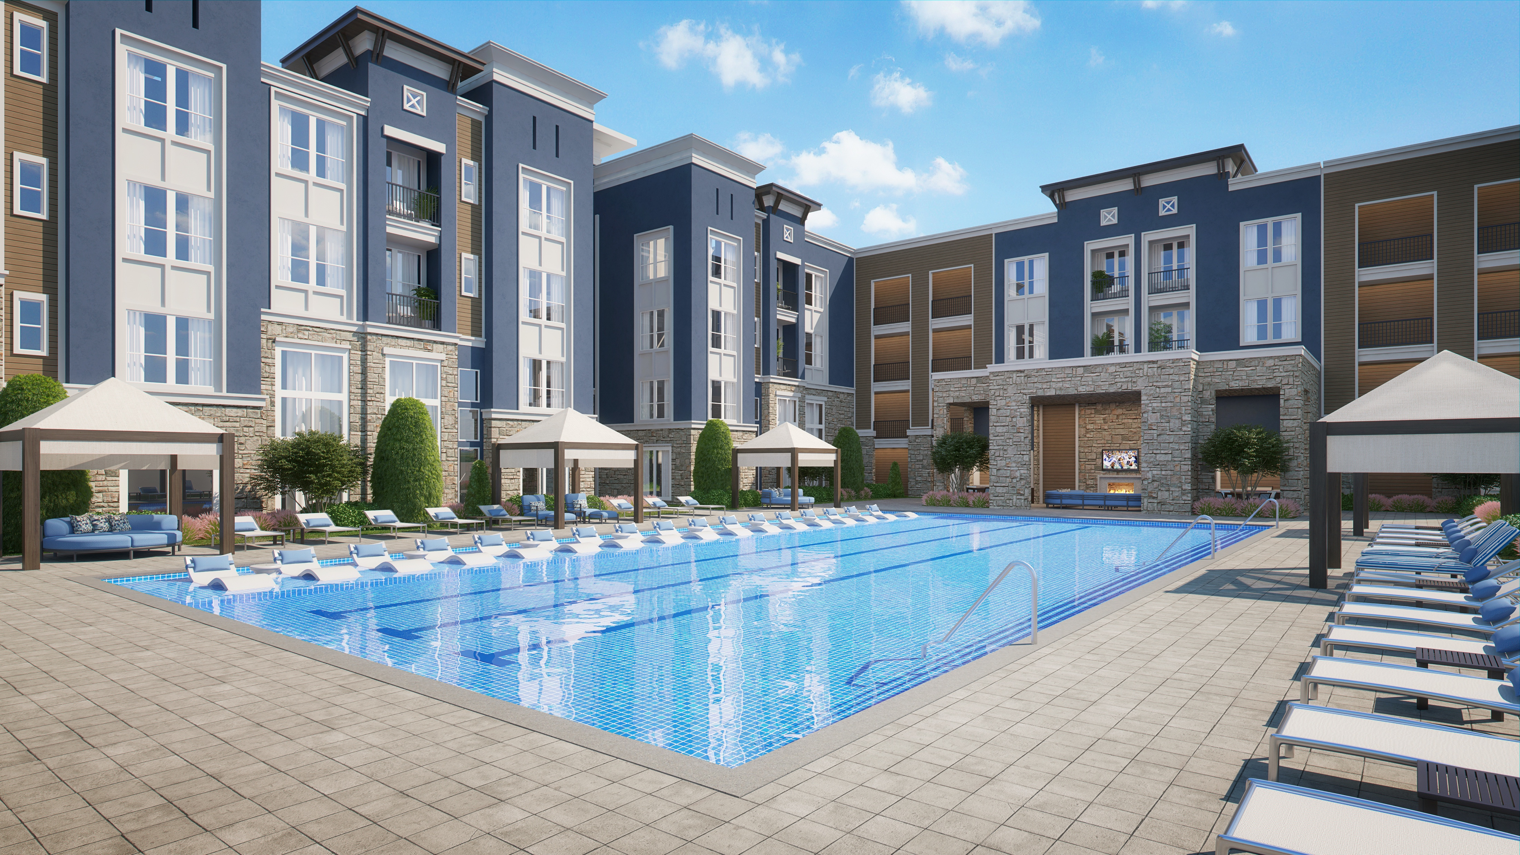
SOVEREIGN ON BROADWAY
A Development Opportunity
950 Third Avenue, Suite 1902
New York, NY 10022

Slide 2
Table of Contents
Executive Summary
Location
Major Employers
Submarket Demographics
Multifamily Market
Investment Merits
Investment Summary
Sources and Uses
Construction Budget
Operating Budget
Rental Assumptions
Project Cash Flows
$1MM Investor Projections
Comparable Multi Family Properties
Principal Biography
Executive Team
Firm History
Contact
3
5
9
10
11
12
13
14
15
16
17
18
19
21
23
24
25
26

Slide 3
Executive Summary
Sovereign Properties has proposed to construct a mixed-use community, comprised of 350 class A residential apartments and 30,000 SF of retail in the Northwood neighborhood of West Palm Beach, FL.
The resort style community will be strategically located minutes away from the beach and West Palm’s hip arts and dining district.
The project was awarded to the developer by the City of West Palm Beach’s Redevelopment Authority.
The developer is undergoing the entitlement and site plan approval process with the City’s Planning and Zoning Commission, with construction expected to commence in early 2022.

Slide 4
Executive Summary
Project Description | Mixed use community with 350 residential apartment units +/- 30,000 SF of retail and 10,000 SF of structured parking
Development Type | 7-story mid-rise construction
Project Location | 2400 Broadway Avenue, West Palm Beach, FL 33407
Loan Amount | Up to $66,000,000
Equity Raise | Up to $22,000,000
Construction Period | 22 months
Est. Financing Close Date | Dec 2021

Slide 5
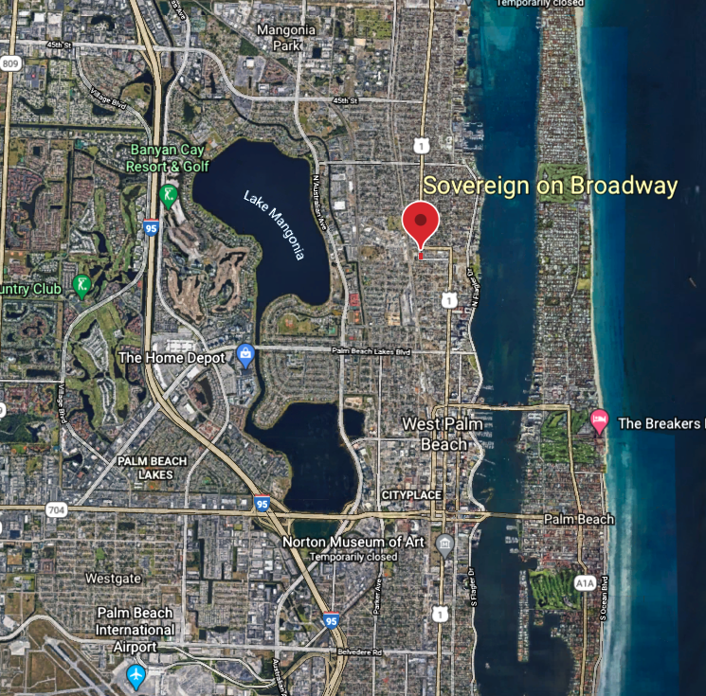
Location
Sovereign on Broadway will be located in West Palm Beach, Florida, in the heart of Palm Beach County.
The community will be situated just off of Route 1 and 5 miles from Interstate 95.
In addition, the newly constructed West Palm Beach Brightline Station will offer residents convenient train access to South Florida’s three business districts and is being extended to reach Orlando.

Slide 6
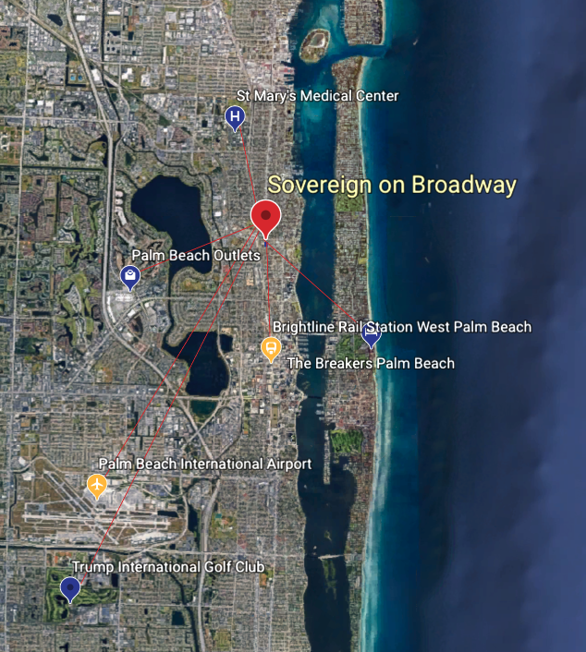
Location
Driving Distance
Brightline Rail Station | 2.0 mi
Saint Mary’s Medical Center | 2.7 mi
The Breakers Palm Beach | 2.8 mi
Palm Beach Outlets | 2.9 mi
Palm Beach Int’l Airport | 5.8 mi
Trump Int’l Golf Club | 7.2 mi

Slide 7
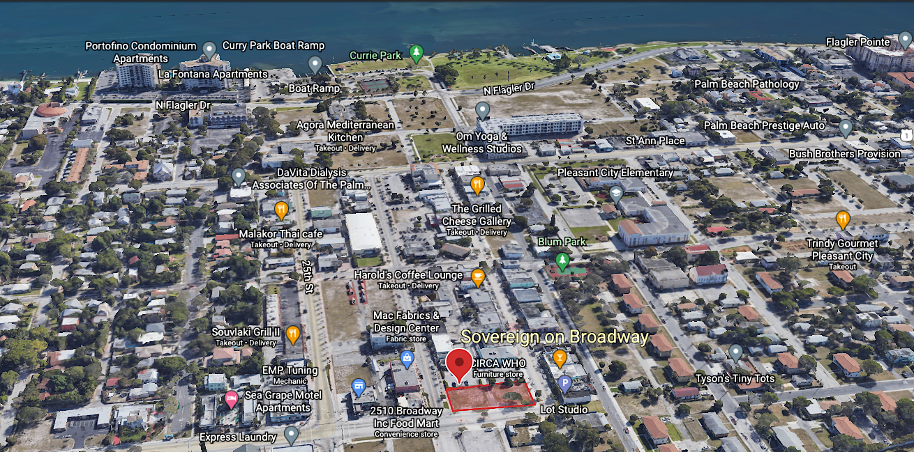
Location
Most of West Palm Beach’s apartment construction in recent years has taken place in the central business district through high-end, mixed-use projects. The Northwood district sits just north of West Palm Beach’s downtown and has received significant support from the city for redevelopment. The city plans to invest $8 million to rejuvenate Curie Park, to the west of Sovereign at Broadway. In addition, the Community Redevelopment Agency unanimously approved plans for at least 3 office towers expected to be built over the next 3 years, in addition to a high-rise residential complex.
This region will be attractive to residents who want to live near downtown but avoid the 7% rent premiums commanded from properties in the central business district.

Slide 8
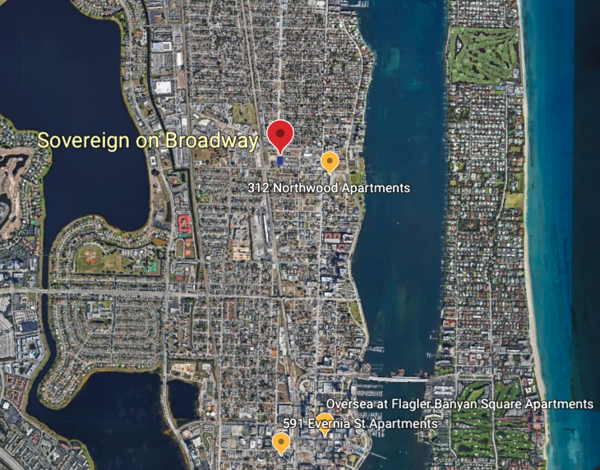
Location
Most of West Palm Beach’s apartment construction in recent years has taken place in the central business district. The Northwood district sits just north of West Palm Beach’s downtown. This region will be attractive to residents who want to live near, but not in, downtown.
There are only 3 apartment communities within a 5-mile radius of our site, with the newest delivery of Oversea at Flagler Banyan Square, closer to the CBD.

Slide 9
Major Employers Top 10 by Employee Count
Palm Beach County School District 22,049 employees (Education)
Tenet Coastal Division Palm Beach County 6,505 employees (Healthcare)
Palm Beach County Board of County Commissioners 5,438 employees (Government)
NextEra Energy, Inc (HQ) 4,807 employees (Utilities)
Florida Atlantic University 2,898 employees (Education)
HCA Healthcare 2,806 employees (Healthcare)
Boca Raton Regional Hospital 2,800 employees (Healthcare)
Veterans Health Administration 2700 employees (Healthcare)
The Breakers 2,300 employees (Hospitality)
Bethesda Hospital 2,282 employees (Healthcare)

Slide 10
Submarket Demographics West Palm Beach¹
POPULATION
MEDIAN AGE
538,190
1.14% annual growth 2020-2025
39.8
NO. EMPLOYEES
MEDIAN HOUSEHOLD INCOME
345,687
2.97% annual growth
$52,638
5.26% annual growth
MEDIAN PROPERTY VALUE
LARGEST INDUSTRIES
$244,686
8.8% annual growth
Healthcare
Retail Trade
Accommodation and Food Services
1. Data sourced from CoStar Analytics – submarket radius - 10 mi from site

Slide 11
Multifamily Market
West Palm Beach is less reliant on tourism than neighboring Fort Lauderdale and Miami. Palm Beach County benefits from a diverse workforce - no single industry accounts for more than 20% of jobs.
West Palm Beach has seen population growth close to 10% over the past 5 years.
Luxury apartment construction in the submarket has been limited. Only 27% of apartment units in the submarket are in the 4- & 5-star level, compared to 42% for the broader metro.
The median West Palm Beach Submarket household income is close to $92,000, about 30% above the Palm Beach metro average.
Multifamily construction has been limited during the past decade and the prelease rate for properties in lease-up is close to 95%.
With 1,500 apartments under construction, much of the development in West Palm Beach is taking place in the central business district.

Slide 12
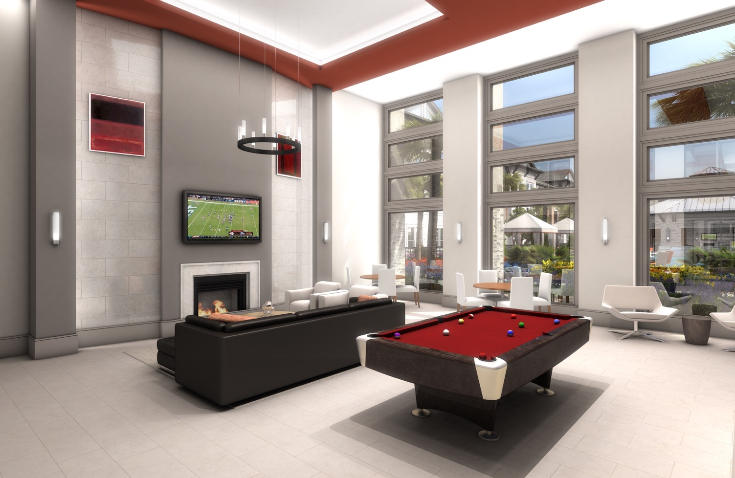
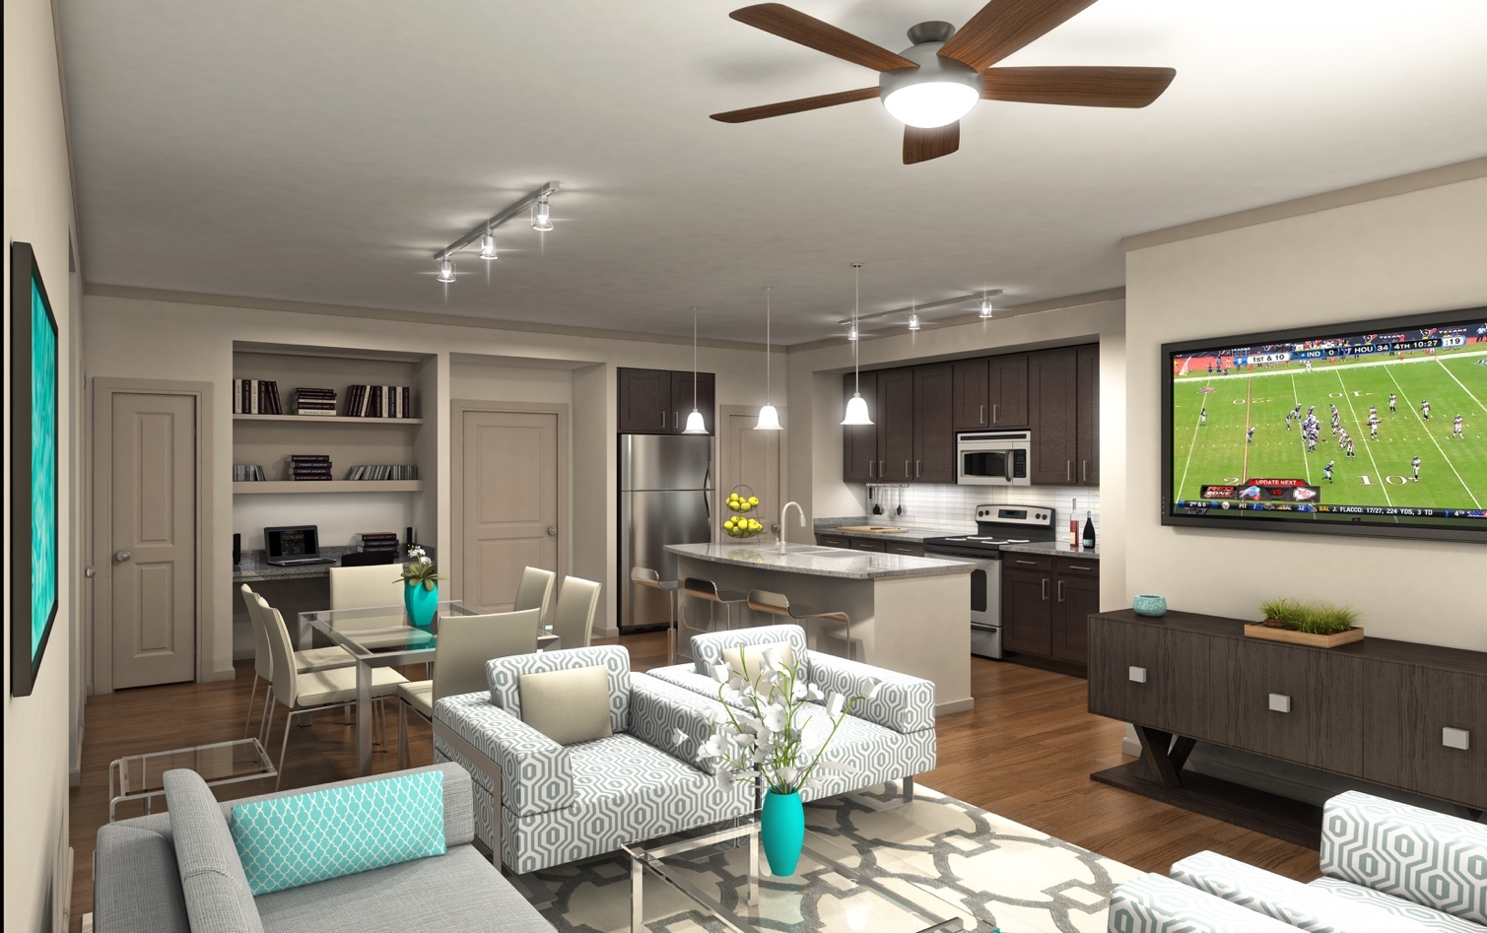
Property Description
Class A Product with Superior Amenities
1, 2, & 3 Bedroom Apartments
State-of-the-art Clubhouse
Wifi-Enabled Business Center/Resident Lounge
Resort-Style Pool
Fitness Center
Outdoor Cabanas and Grill Area
Parking Garage
Market-Leading Finishes
Stainless Steel Appliances
Granite Countertops in Kitchens/Bathrooms
Vinyl Plank Flooring
Oversized Walk-in Closets
In-Unit Washer/Dryer

Slide 13
Investment Summary
Total Project Costs: | $87,890,469
Construction Loan Amount: | $65,917,852
Equity Contribution: | $21,972,617
Minimum Investment: | $250,000.00
Preferred Equity Return: | 8%
Excess Profit % Share LP/GP: | 75/25
Investor IRR: _{(Sell at Stabilization)} | 24.74%
Investor IRR: _{(Build and Hold)} | 20.05%

Slide 14
Sources and Uses
Sources
Senior Loan | $ 65,917,851.88
Equity | $ 21,972,617.29
Total Sources | $ 87,890,469.18
Uses
Land Purchase | $ 4,000,000.00
Hard Costs | $ 58,000,000.00
Hard Cost Contingency | $ 6,090,000.00
General Contractor Fee | $ 2,900,000.00
Soft Costs | $ 13,254,967.17
Soft Cost Contingency | $ 265,099.34
Developer Fee | $ 3,380,402.66
Total Uses | $ 87,890,469.18

Slide 15
Construction Budget
HARD COSTS
Site Work + Vertical Construction | $ 58,000,000
General Contractor Fee (5%) | $ 2,900,000
Total Hard Costs | $ 66,990,000
Hard Cost Contingency (10%) | $ 6,090,000
Land Costs
Land Purchase | $ 4,000,000
SOFT COSTS
Property Tax Holdback | $ 600,000
Insurance Holdback | $ 600,000
Senior Loan Interest Holdback | $ 5,452,967
Closing Costs | $ 1,700,000
Engineering | $ 400,000
Plans | $ 550,000
Permits | $ 250,000
Impact Fees | $ 1,000,000
Operating Start Up Cost | $ 300,000
Waterproofing Consultant/CMT | $ 100,000
Fulcrum | $ 75,000
SWPPP | $ 17,000
Designer FF&E | $ 450,000
B/D Fee | $ 1,760,000
Total Soft Costs | $ 13,054,967
Soft Cost Contingency (2%) | $ 265,099
Developer Fee (4%) | $ 3,380,403
Total Contract | $ 87,890,469,18
Total Cost PSF | Cost/Unit
$317.21 | $251,116

Slide 16
Operating Budget
Number of Units | 350
 | Per Unit |  | Year 1 | Year 2 | Year 3 | Year 4
Scheduled Market Rent |  |  | $7,232,044 | $7,420,077 | $7,612,999 | $7,810,937
RUBS Income | $690.05 |  | $241,516 | $247,795 | $254,238 | $260,848
Ancilliary Income | $168.07 |  | $58,826 | $60,355 | $61,925 | $63,535
Other Income | $659.40 |  | $230,790 | $236,791 | $242,947 | $249,264
Gross Potential Income |  |  | $7,763,176 | $7,965,019 | $8,172,109 | $8,384,584
Less: Vacancy & Collection Loss | 5.0% |  | -$388,159 | -$398,251 | -$408,605 | -$419,229
EFFECTIVE GROSS INCOME (EGI) |  |  | $7,375,017 | $7,566,768 | $7,763,504 | $7,965,355
 | Stabilized
Operating Expenses: | $ Per Unit | % of EGI
Management Fee | 345.91 | 2.25% | $165,938 | $170,916 | $176,044 | $181,325
Payroll | 437.68 | 2.08% | $153,187 | $157,782 | $162,516 | $167,391
Leasing & Advertising | 500.00 | 2.37% | $175,000 | $180,250 | $185,658 | $191,227
Utilities | 811.82 | 3.85% | $284,136 | $292,660 | $301,440 | $310,483
Repairs & Maintenance | 875.35 | 4.15% | $306,373 | $315,564 | $325,031 | $334,782
Real Estate Taxes | 1,545.98 | 7.34% | $541,094 | $557,327 | $574,047 | $591,268
Administrative Expense | 663.57 | 3.15% | $232,251 | $239,218 | $246,395 | $253,786
Insurance | 374.14 | 1.78% | $130,950 | $134,878 | $138,925 | $143,092
Replacement Reserve | 600.04 | 2.85% | $210,014 | $216,314 | $222,804 | $229,488
Total Operating Expenses | 6,154.49 | 29.82% | $2,198,942 | $2,264,910 | $2,332,857 | $2,402,843
APARTMENT NET OPERATING INCOME |  |  | $5,176,075 | $5,301,858 | $5,430,646 | $5,562,512
Office/Retail Income |  |  | $405,600 | $417,768 | $430,301 | $443,210
NET OPERATING INCOME |  |  | $5,581,675 | $5,719,626 | $5,860,947 | $6,005,722

Slide 17
Rental Assumptions
Residential | Unit Type | No. Units | SF/Unit | Total RSF | Rent PSF | Rent/Unit | Total Annual Rent/Unit Type
79% | 1bd/1bath | 247 | 620 | 153,140 | $2.58 | $1,597 | $4,732,026
 | 1bd/1bath | 28 | 620 | 17,360 | $2.32 | $1,437 | $482,782
21% | 2bd/2bath | 68 | 1021 | 69,428 | $2.21 | $2,261 | $1,844,980
 | 2bd/2bath | 7 | 1021 | 7,147 | $2.01 | $2,051 | $172,257
100% | Total: | 350 | 706 | 247,075 | $2.44 | $1,722 | $7,232,044
Retail | Lease Type | SF | Gross Rent PSF | Net Rent PSF | Avg. Occupancy | Total Annual NNN Rent
 | NNN | 30,000 | $25.00 | $16.90 | 80% | $405,600

Slide 18
Project Cash Flows
Develop and Sell
Term in years | Equity invested | Debt Service | Asset Management Fee | Total | Net Operating Income | Equity Return | 8% Pref | Sales Profit | Total | Project Cash Flow | Investors Cash Flow
0 | -$21,972,617 | $0 |  | -$21,972,617 |  | $0 |  | $0 | $0 | -$21,972,617 | -$21,972,617
1 |  | $0 |  | $0 | $0 | $0 | $0 | $0 | $0 | $0 | $0
2 |  | $0 |  | $0 | $0 | $0 | $0 | $0 | $0 | $0 | $0
3 |  | -$3,189,529 | -$219,726 | -$3,409,255 | $5,581,675 | $21,972,617 | $4,394,523 | $21,182,330 | $26,764,005 | $49,941,617 | $42,649,548
 |  |  |  |  |  |  |  |  | Net Cash Flow | $27,969,000 | $20,676,931
 |  |  |  |  |  |  |  |  | Project IRR | 31.48% | 24.74%
Assumptions:
4.87% Cap Rate
3% Annualized Growth Rate
Develop and Hold
Term in years | Equity Invested | Debt Service | Asset Management Fee | Total | Net Operating Income | Equity Return | 8% Pref. | Sales Profit | Total Income | Project Cash Flow | Investors Cash Flow
0 | $21,972,617 | $0 |  | $21,972,617 | $0 |  |  | $0 | $0 | -$21,972,617 | -$21,972,617
1 | $0 | $0 |  | $0 | $0 |  |  | $0 | $0 | $0 | $0
2 | $0 | $0 |  | $0 | $0 |  |  | $0 | $0 | $0 | $0
3 | $0 | -$3,189,529 | -$219,726 | -$3,409,255 | $5,581,675 | $10,223,226 | $4,394,523 | $0 | $9,976,199 | $17,009,896 | $16,072,526
4 | $0 | -$3,189,529 | -$219,726 | -$3,409,255 | $5,749,126 |  | $939,951 | $0 | $5,749,126 | $2,559,597 | $1,853,977
5 | $0 | -$3,189,529 | -$219,726 | -$3,409,255 | $5,921,599 |  | $939,951 | $0 | $5,921,599 | $2,732,071 | $1,974,709
6 | $0 | -$3,189,529 | -$219,726 | -$3,409,255 | $6,099,247 |  | $939,951 | $0 | $6,099,247 | $2,909,719 | $2,099,062
7 | $0 | -$3,189,529 | -$219,726 | -$3,409,255 | $6,282,225 | $11,749,391 | $939,951 | $32,900,440 | $39,182,665 | $47,742,527 | $37,006,846
 |  |  |  |  |  |  |  |  | Net Cash Flow | $50,981,192 | $37,034,502
 |  |  |  |  |  |  |  |  | Project IRR | 24.39% | 20.05%
Assumptions:
Refinance Month 30
Refi Loan 70% LTV
3% Annualized Growth Rate
4% Interest on Stabilized Refinance Debt
5.00% Cap Rate

Slide 19
$1MM Investor Returns Develop and Sell
Term in years | Principal Invested | Sales Profit | Preferred Return | Net Operating Income | Net Income Before Taxes | Gross Cash Flow to Investor
0 | -$1,000,000 |  |  |  | $0 | -$1,000,000
1 |  |  |  |  | $0 | $0
2 |  |  |  |  | $0 | $0
3 | $1,000,000 | $674,823 | $200,000 | $69,209 | $944,032 | $1,941,032
Total | $0 | $674,823 | $200,000 | $69,209 | $944,032 | $941,032
 |  |  |  |  | Investor IRR | 24.74%

Slide 20
$1MM Investor Returns Develop and Hold
Term in years | Return of Principal | Preferred Return (8%) | Excess Operating Income to Investor | Sales Profit | Investor's Tax Write Off - $1MM Investment | Net Income Before Taxes | Gross CF to Investor
0 | -$1,000,000 |  |  |  | $0 | $0 | -$1,000,000
1 |  |  |  |  | $0 | $0 | $0
2 |  |  |  |  | $0 | $0 | $0
3 | $465,271 | $200,000 | $66,209 |  | $97,184 | $169,024 | $731,480
4 |  | $42,778 | $41,598 |  | $97,184 | -$12,808 | $84,377
5 |  | $42,778 | $47,093 |  | $97,184 | -$7,313 | $89,871
6 |  | $42,778 | $52,753 |  | $97,184 | -$1,653 | $95,531
7 | $534,729 | $42,778 | $58,582 | $1,048,137 | $97,184 | $1,052,313 | $1,684,226
Total | $0 | $371,113 | $266,234 | $1,048,137 | $485,922 | $1,199,563 | $1,685,484
 |  |  |  |  |  | Investor IRR | 20.05%

Slide 21
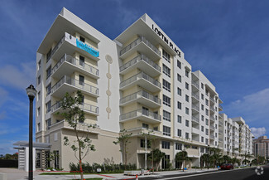
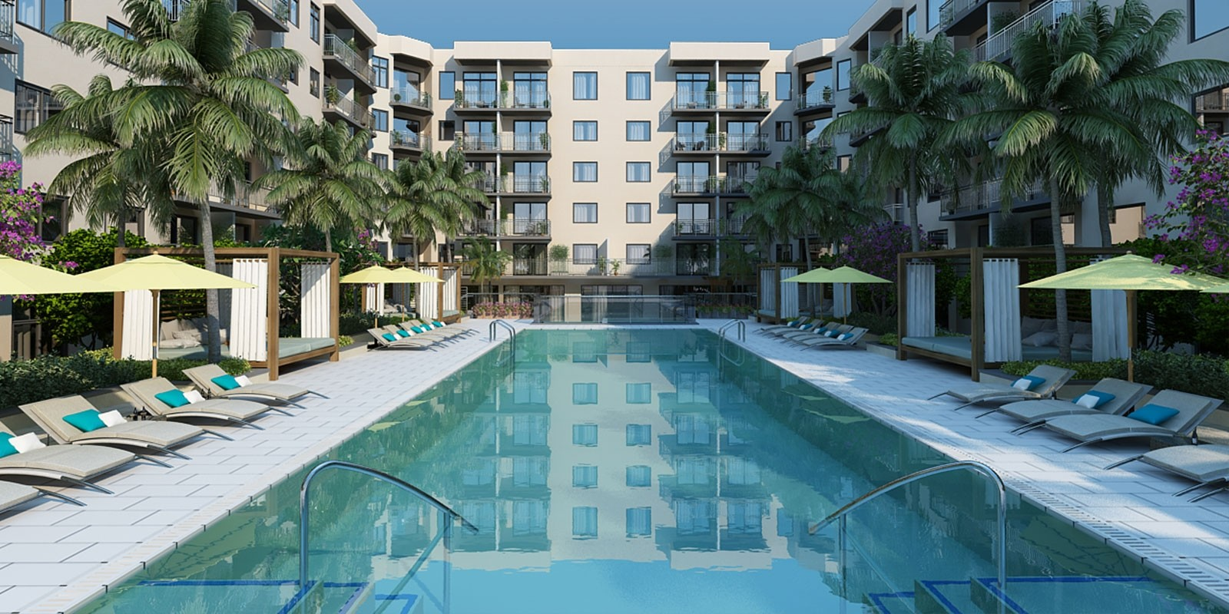
Comparable Multifamily Properties
312 Northwood
Address 312 23rd Street
West Palm Beach, FL 33407
# Units 99
Year Built 2017
Avg. Unit Size 774
Avg. Effective Rent PSF $2.17
Occupancy 98%
Loftin Place
Address 805 N Olive Ave
West Palm Beach, FL 33401
# Units 259
Year Built 2016
Avg. Unit Size 826
Avg. Effective Rent PSF $2.24
Occupancy 92%
Oversea at Flagler Banyan Square
Address 290 N Olive Ave
West Palm Beach, FL 33401
# Units 251
Year Built 2020
Avg. Unit Size 874
Avg. Effective Rent PSF $2.99
Occupancy 41%

Slide 22
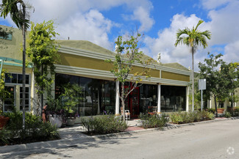
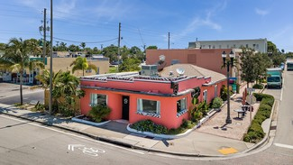
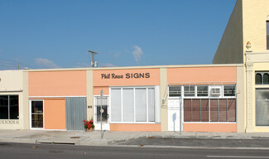
Comparable Retail Properties
Single Tenant Restaurant
Storefront Retail
Address 2500 Broadway
West Palm Beach, FL 33407
Year Built 1946
SF GLA 1,850
Est. NNN Rent $18-$22
Address 805 Dixie Hwy
West Palm Beach, FL 33407
Year Built 1945
SF GLA 4,200
Est. NNN Rent $17-$21
Storefront Retail
Address 805 Dixie Hwy
West Palm Beach, FL 33401
Year Built 1937
SF GLA 3,659
Est. NNN Rent $29-$36

Slide 23
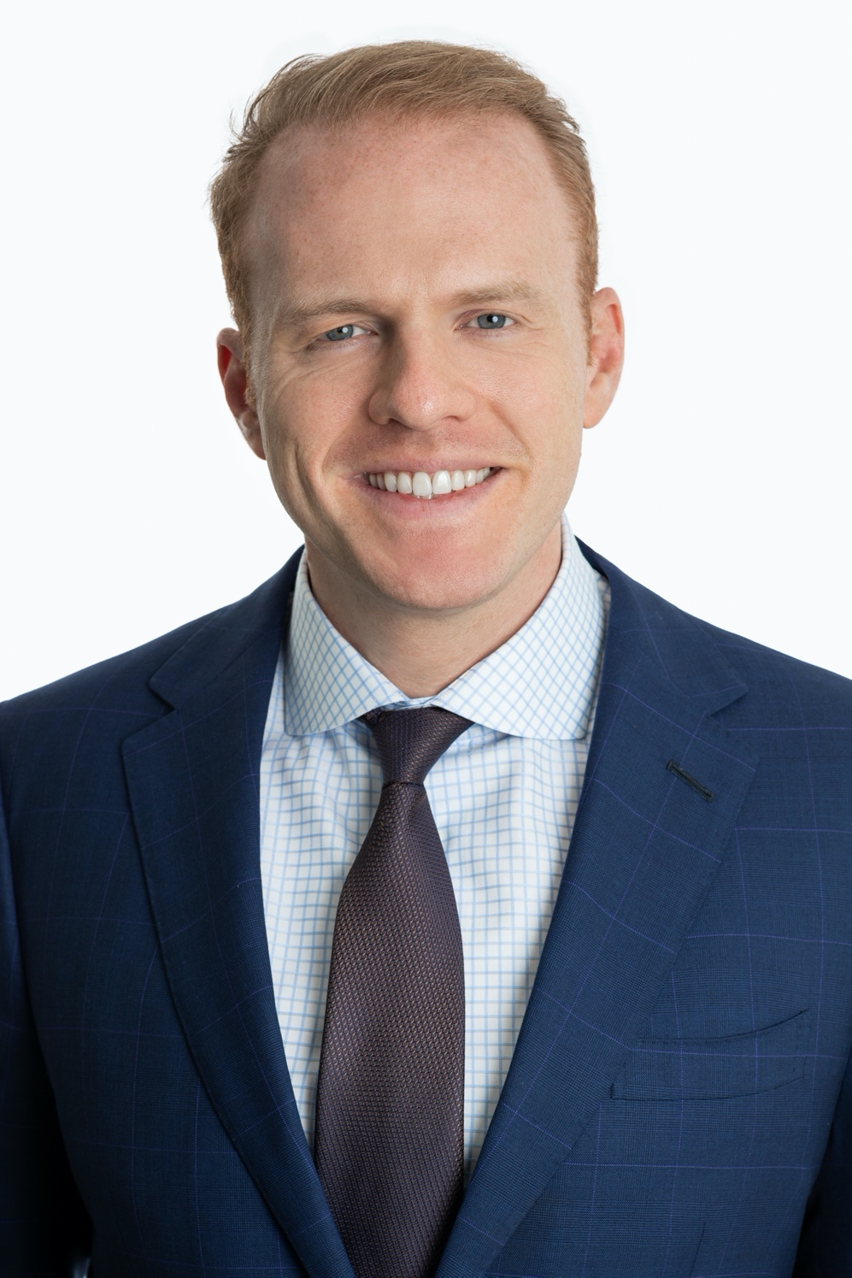
Principal Biography
Russ Krivor developed an interest in real estate at a young age. Russ spent his teenage summers working at his uncle’s high-rise and commercial construction sites in Chicago. While studying Economics at Northwestern University, he observed an incredible demand for affordable single-family homes in south Florida. Eager to take advantage of the market opportunity, Russ, founded his own property development company in 2004. The firm initially set out to build 5-10 homes annually. By the end of 2006, they had built and sold over 200 homes.
Recognizing the trend away from home ownership in 2008, Russ wanted to transform the firm into a powerhouse of multifamily development-with a strong focus on upscale suburbs. He approached a family friend for equity and invested a great deal of his own money. In 2010 Dolce Living Mansfield opened its doors. Since then, Mr. Krivor and his companies have constructed nearly 5,000 apartments across the country, targeting high income areas with limited supply across submarkets in Dallas, Houston, Orlando, Minneapolis, and Chicago.

Slide 24
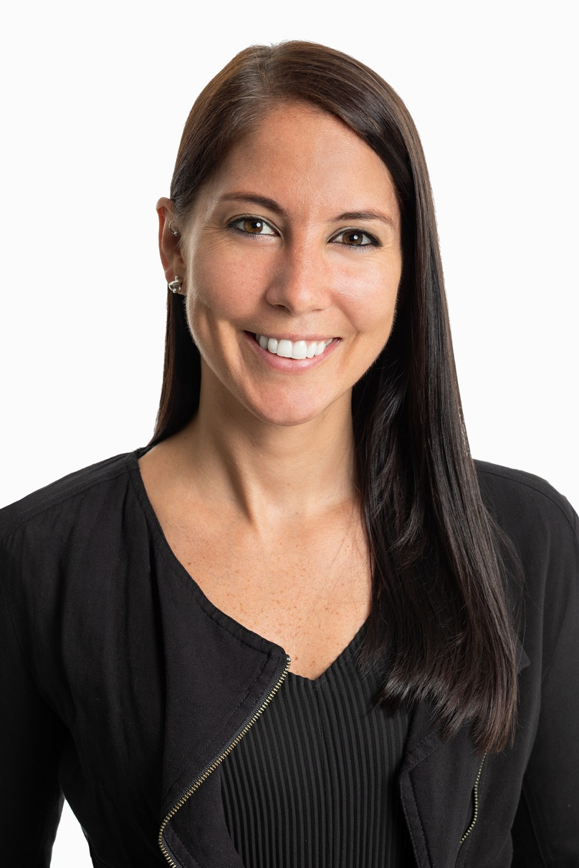
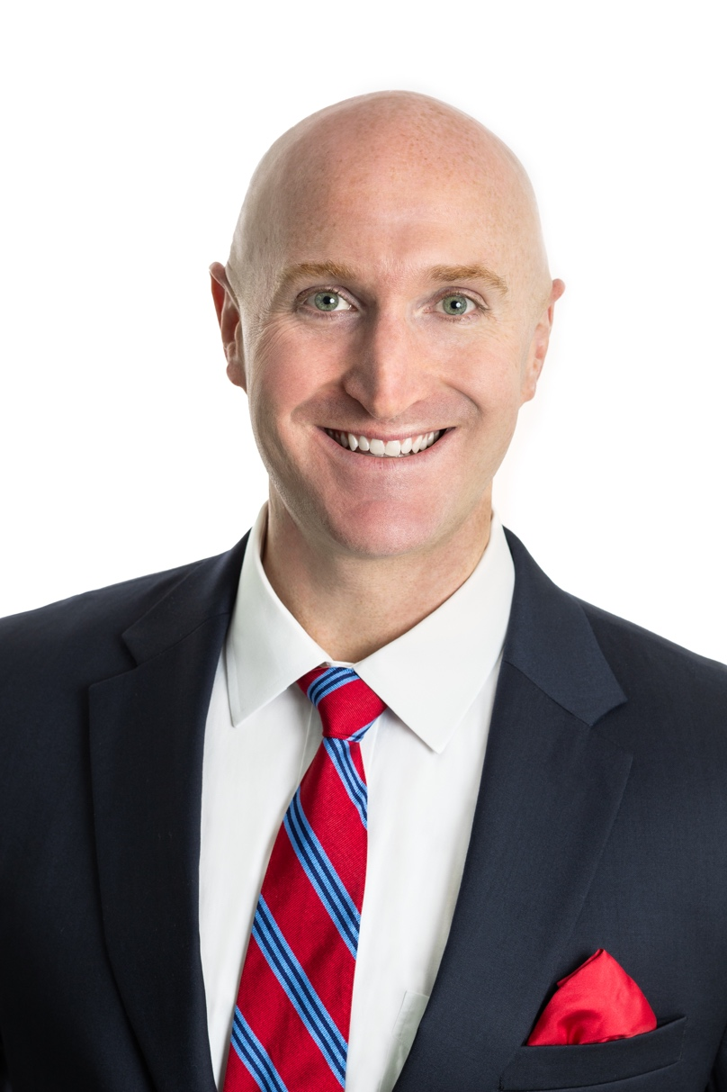
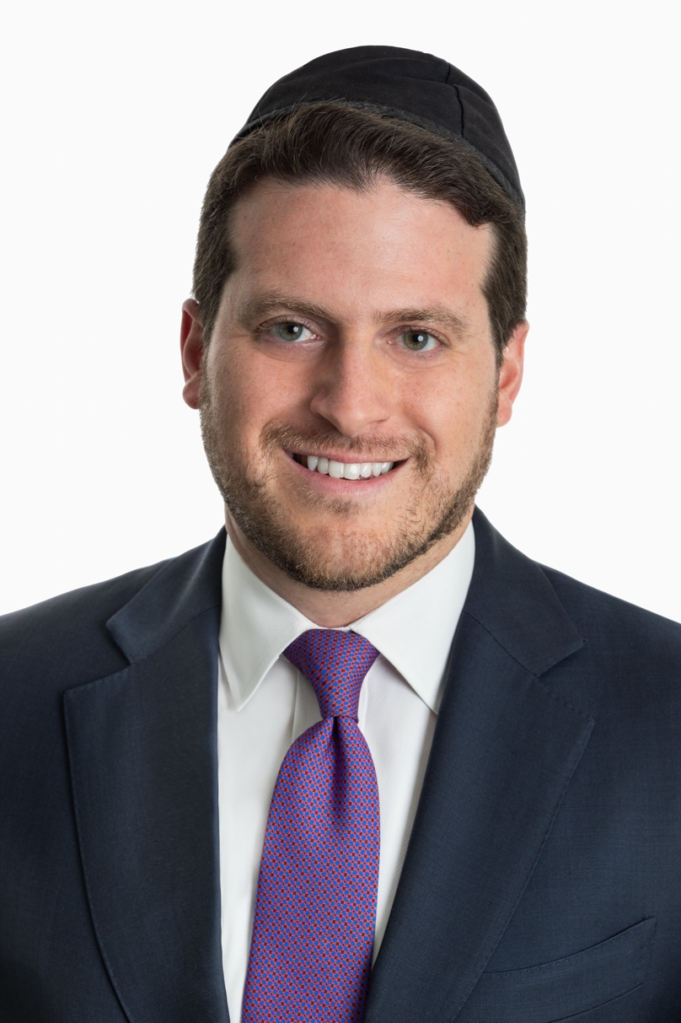
Executive Team
Katie Clarke, MBA | VP, Investor Relations and Finance
Katie Clarke is Vice President of Investor Relations and Finance at Sovereign Properties where she is responsible for all aspects of Sovereign’s capital raising activities. Katie manages the firm’s relationships with new and existing debt and equity partners and supports the investment team in identifying, underwriting, and closing new investments. In addition, Katie is responsible for implementing Sovereign’s Investor and Public Relations strategy, including drafting quarterly newsletters, monthly construction reports, and responding to other ad hoc investor requests.
Prior to joining Sovereign Properties, Katie spent 6 years in an investor relations role at Buckingham Capital Management, a Manhattan-based hedge fund with approximately $700 million in assets under management. Katie holds a Master’s degree in Business Administration from Fordham University’s Gabelli School of Business and a Bachelor’s degree in Accounting from the University of Delaware.
Ryan Lang | VP, Development and Operations
Ryan Lang is the Vice President of Development and Operations at Sovereign Properties where he is responsible for all aspects of the development process including land acquisition, planning and design, securing entitlement approvals and building permits, budgeting, underwriting, construction reporting, project close-out and leasing support. Ryan oversees and works closely with the architect, engineers, general contractor, consultants, brokers, and property management team to ensure projects are executed on schedule and within budget.
Prior to joining Sovereign, Ryan spent 8 years in a similar position for Gulfshore Development LLC in Naples, FL, where he provided leadership and management oversight for the development of a new luxury waterfront condominium project called Naples Casamore. After completion and sellout, with Ryan’s guidance, his development team created a trend defining residence in the ultra affluent Port Royal neighborhood that eclipsed all previous records for spec home sales. Ryan holds his Bachelor’s degree from Georgetown University.
Albert Sardar, Esq. | General Counsel
Albert Sardar is the General Counsel of Sovereign Properties where he is responsible for all legal matters concerning the firm and its principle, on a broad range of national real estate transactions, ranging from corporate formation and governance, joint ventures, mortgage, mezzanine and construction financing, debt restructurings, acquisitions and dispositions of commercial, residential and mixed-use projects, to construction and leasing.
Prior to joining Sovereign, Mr. Sardar was a partner at Silverman & Sardar LLP where he developed widespread experience in the area of real estate transactions, specifically with regards to the acquisition, sale and leasing of retail and mixed-use properties, lease restructurings, condominium developments (retail and mixed-use), and counseling clients on lease issues (such as exclusives, radius restrictions, assignment/subletting and "going dark") in anticipation of and during a lease dispute. Additionally, Mr. Sardar has experience negotiating complex shopping center leases and appearing before various state courts in New York. Over the years, Mr. Sardar has developed a working relationship with many of the major shopping center developers in the United States.
Mr. Sardar earned his Juris Doctorate from the Benjamin N. Cardozo School of Law and is admitted to practice law in the states of New York and New Jersey.

Slide 25
Firm History
Who We Are:
Sovereign Properties, led by Russ Krivor, is a fully-integrated property development firm in the multifamily arena. Since 2004, principal Russ Krivor has been engaged in the concept, development, construction, and project management of income generating real estate in the strongest job-growth markets across the United States. As a result of this conservative approach to real estate, Mr. Krivor and Sovereign Properties have been able to assemble over $300 million in equity under management, resulting in nearly 5,000 completed and leased apartments.
The Sovereign strategy is twofold: One, we focus on high-growth sunbelt markets where population growth and job-growth continue to significantly outpace the broader United States. Secondly, we construct rental properties for middle-class professionals and charge mid-range rental rates in niche suburbs with top-rated school districts, high median incomes, and difficult zoning (creating barriers to entry for our competitors).
We live by the mantra that, “At every income level, the tenant wants to live in a luxurious, comfortable home.” We outfit our reasonably-priced apartment homes with single-family style upgrades like quartz countertops, stainless steel appliances, and solid wood cabinets. Finally, we provide residents with luxurious amenities like resort-style swimming pools, demonstration kitchens and spinning studios.
Through our continual focus on pro-forma integrity, market selection, and high quality living spaces, we believe Sovereign’s portfolio of tangible assets will continue to generate positive cash flow and industry-leading returns.

Slide 26
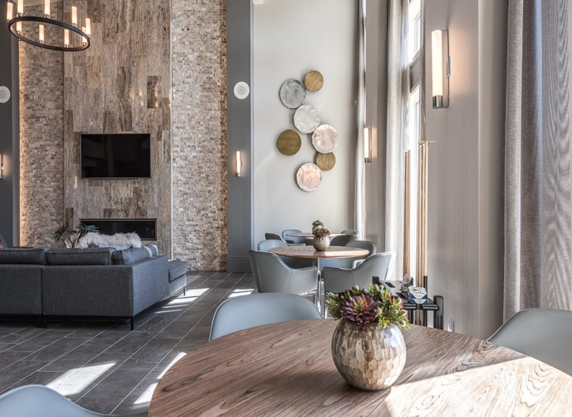
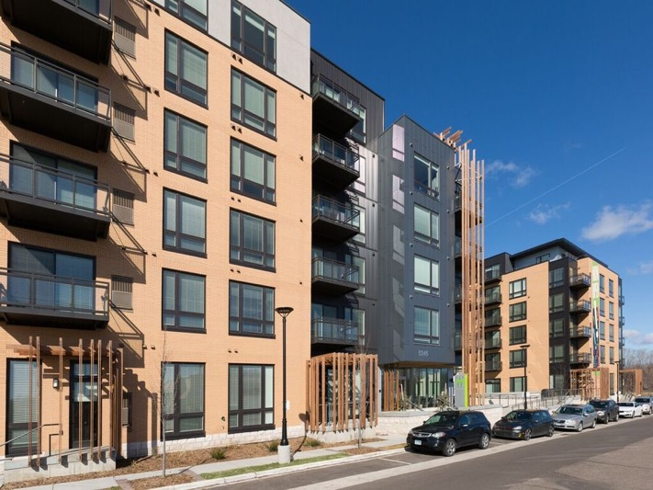
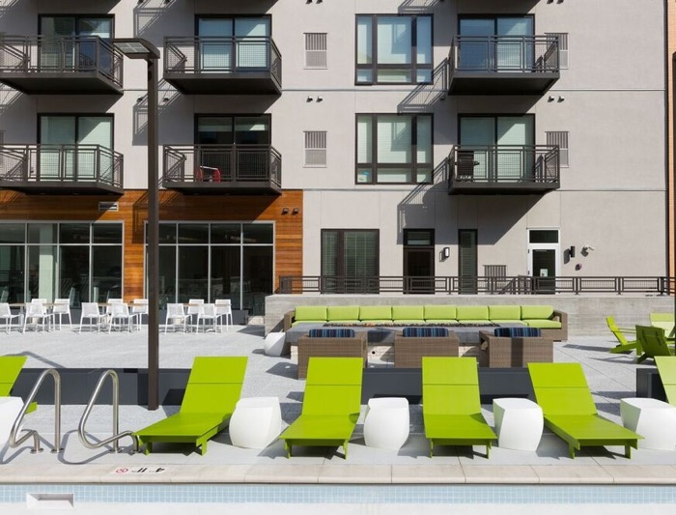
Contact
Sovereign Properties
950 Third Avenue, Suite 1902
New York, New York 10022
Main: (212) 224-9620
Rkrivor@sovereignprop.com

